Slide 1
Operating Systems CS2006
Chapter: 3
Process Management
Part 1

Slide 2
Process
A computer program in execution on a machine is a process
More formally:
 A Sequential stream of Execution in its own address space

Slide 3
Process Address Space
A list of memory locations from some min (usually 0) to some max that a process can read and write.
Contains
the executable program
program’s data
Stack
Associated with a process is a set of registers e.g. PC, SP and other information to run the program.

Slide 4
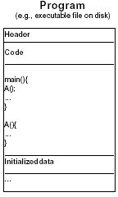
Process =? Program
 Program: series of commands (e.g. C statements, assembly commands, shell commands)

Slide 5
Process
A process consists of
Code (text) section
Data section
Stack
Heap
CPU State (program counter, etc.)
Environment
Process control block (PCB)

Slide 6
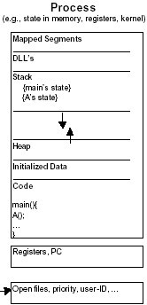

Slide 7
CPU State
CPU registers contain the current state
Program Status Word (PSW): includes bits
Instruction Register (IR):
Program Counter (PC):
Stack Pointer (SP):
General purpose registers:

Slide 8
Memory Contents
Only a small part of an application’s data can be stored in registers.The rest is in memory.
Typically divided into a few segments:
Text/application code
Data
Heap
Stack
All the addressable memory together is called?
The process's address space.

Slide 9
Environment
Contains the relationships with other entities
A process does not exist in a vacuum
It typically has connections with other entities, such as
A terminal where the user is sitting.
Open files
Communication channels to other processes, possibly on other machines.

Slide 10
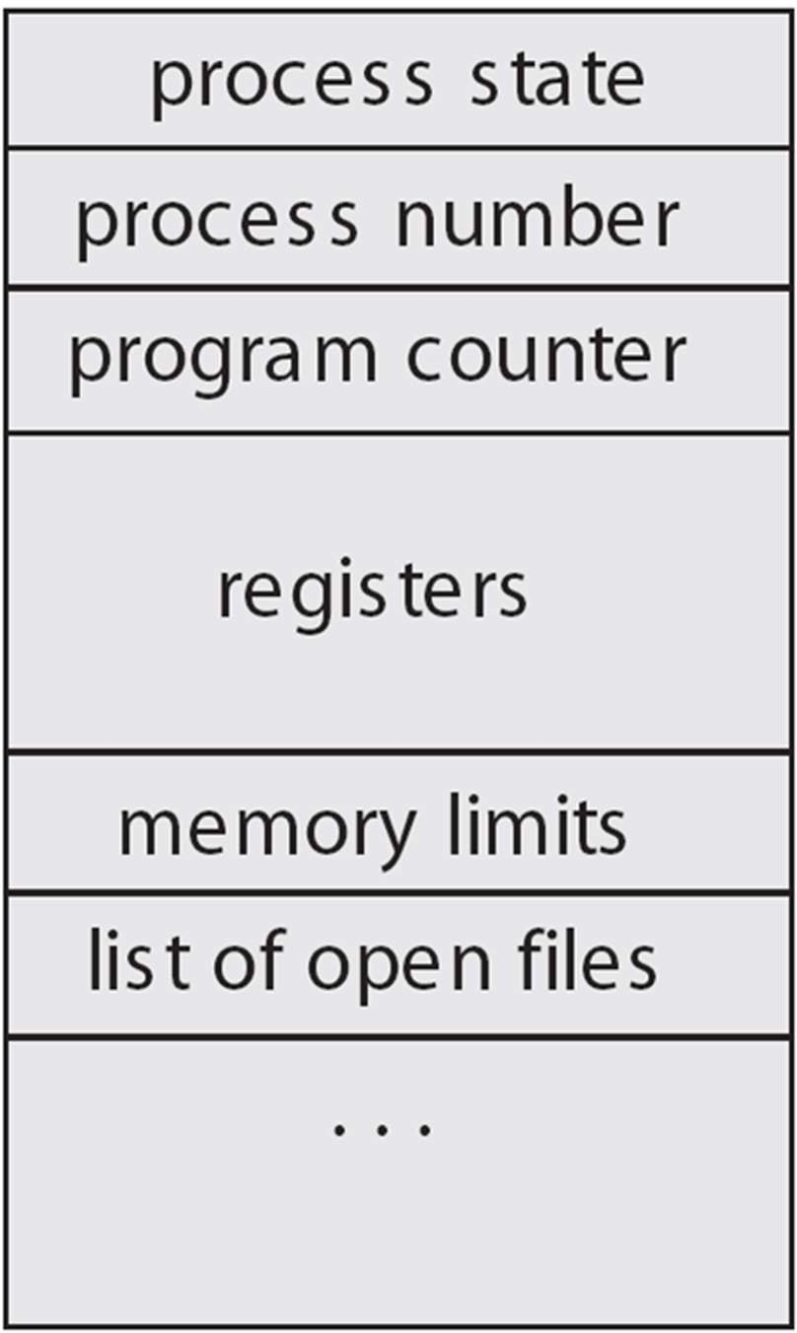
Process Control Block (PCB)
The OS keeps all the data it needs about a process in the process control block (PCB)
Thus another definition of a process:
“the entity described by a PCB”
This includes many of the data items described above, or at least pointers to where they can be found
e.g. for the address space

Slide 11
Process Control Block (PCB)
PCB is "the manifestation of a process in an operating system”.
Data Structure defined in the operating system kernel containing the information needed to manage a particular process.
It must be kept in an area of memory protected from normal user access.

Slide 12
Process Control Block (PCB)
PCB contains the Process information and attributes
Process state
Program counter
CPU registers
CPU scheduling information
Memory management information
Accounting information
I/O status information
Per process file table
Process ID (PID)
Parent PID, etc.

Slide 13
Process Identification
Process ID, a unique numeric identifier
User ID
Who runs the process.Why?
Used to determine what access rights the process has

Slide 14
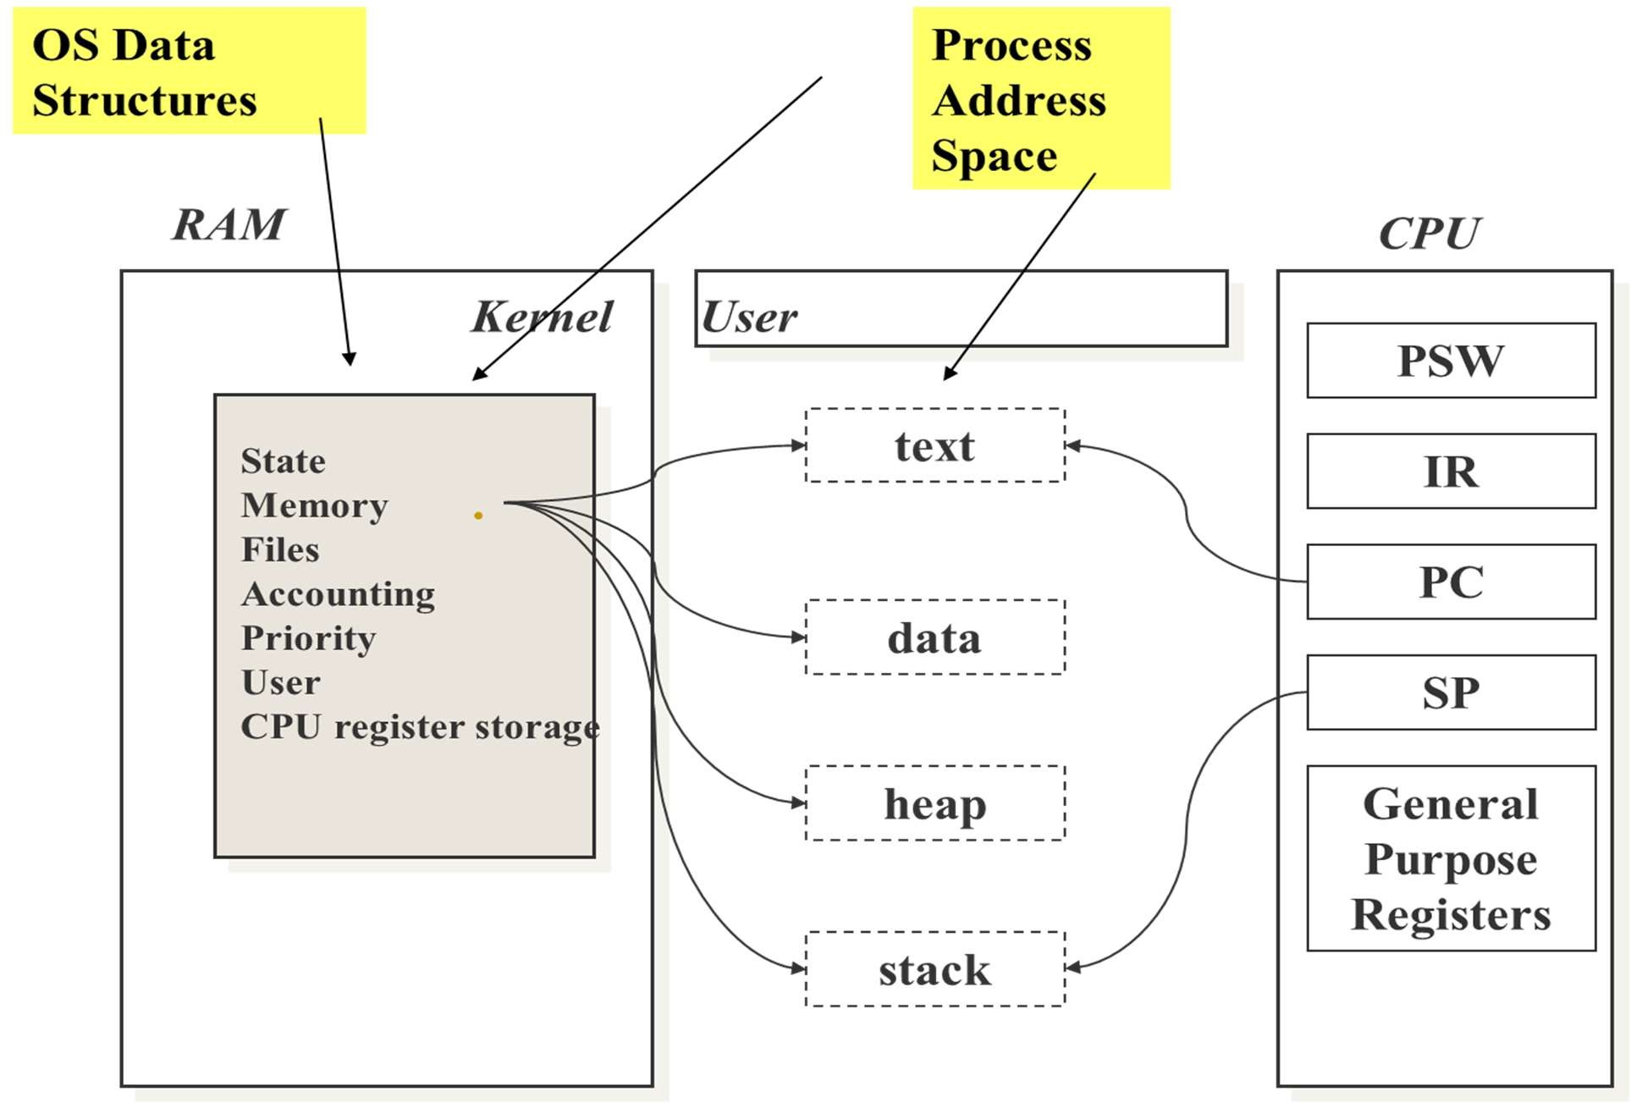
Process Control Block

Slide 15
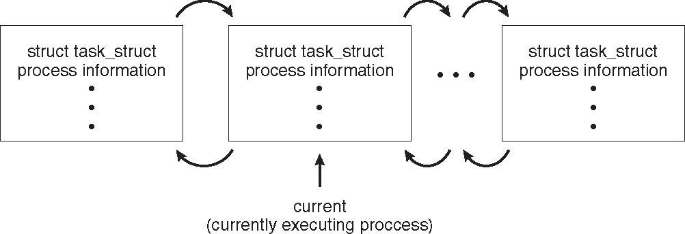
Process Representation in Linux
Represented by the C structure task_struct
pid_t pid; /* process identifier */ long state; /* state of the process */
unsigned int time_slice /* scheduling information */
struct task_struct *parent; /* this process’s parent */ struct list_head children; /* this process’s children */ struct files_struct *files; /* list of open files */ struct mm_struct *mm; /* address space of this process */

Slide 16
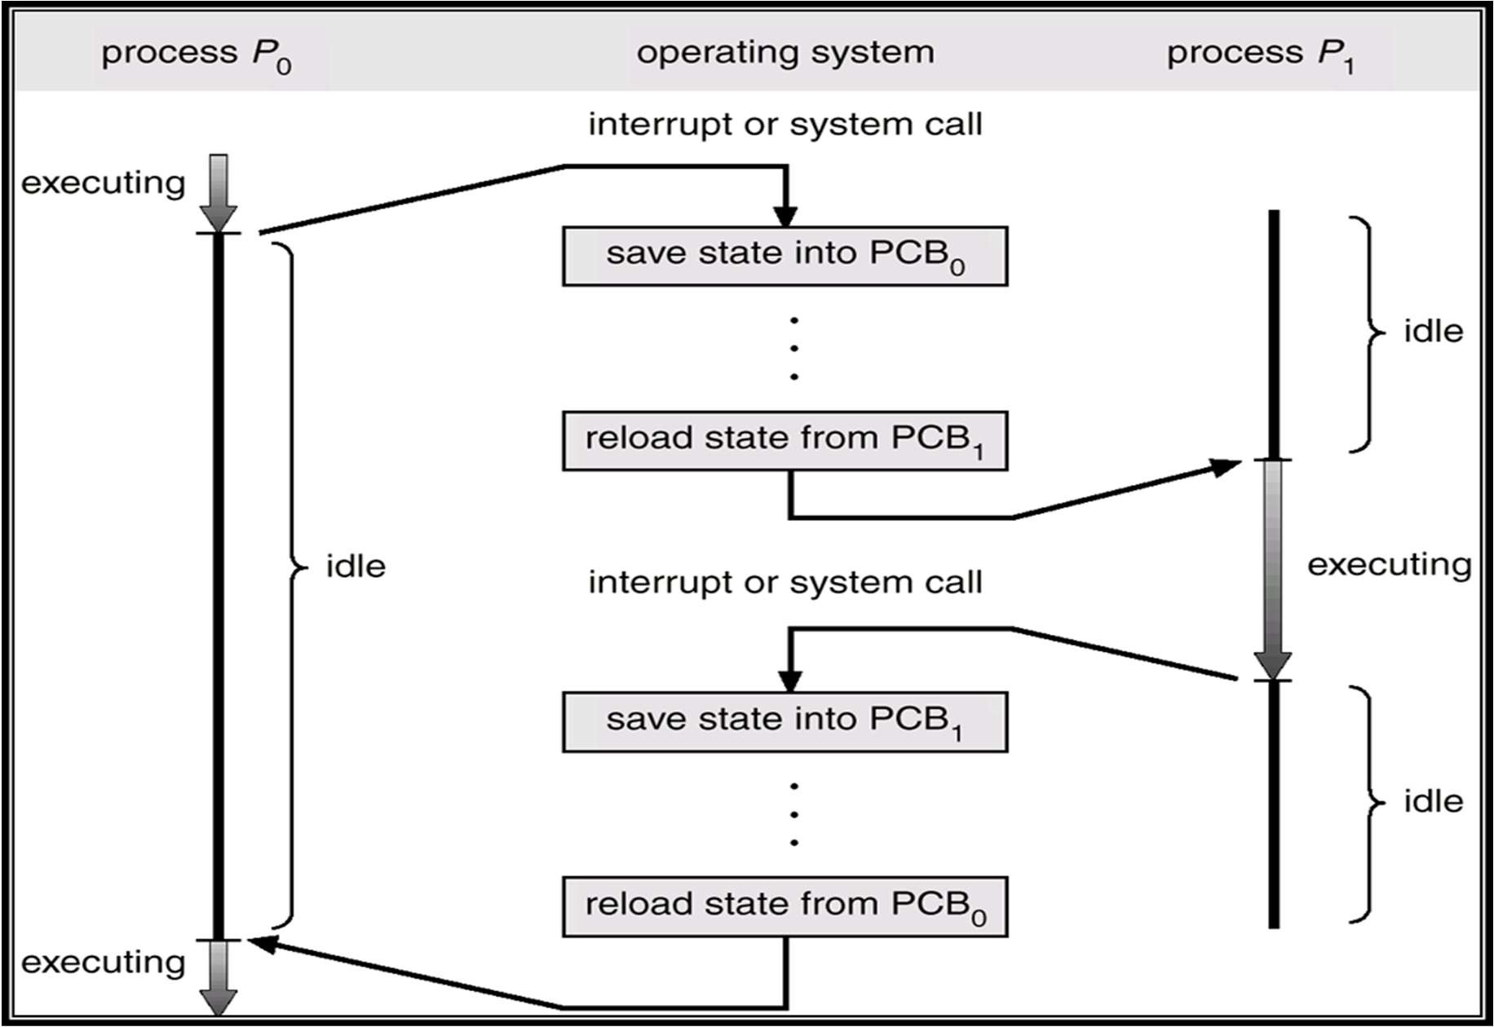
CPU Switch From Process to Process

Slide 17
CPU Switch From Process to Process
Switching a process requires
Saving the state of old process
Loading the saved state of the new process
This is called Context Switch
Part of OS responsible for switching the processor among the processes is called Dispatcher

Slide 18
Process States
At any given time a process is either running or not running
Number of states
Running
Not Running
When the OS creates a process, the process is entered into Not Running state

Slide 19
Five-state Process Model
Running: currently being run
Ready: ready to run
Blocked: waiting for an event (I/O)
New: just created, not yet admitted to set of run-able processes
Exit: completed/error exit

Slide 20
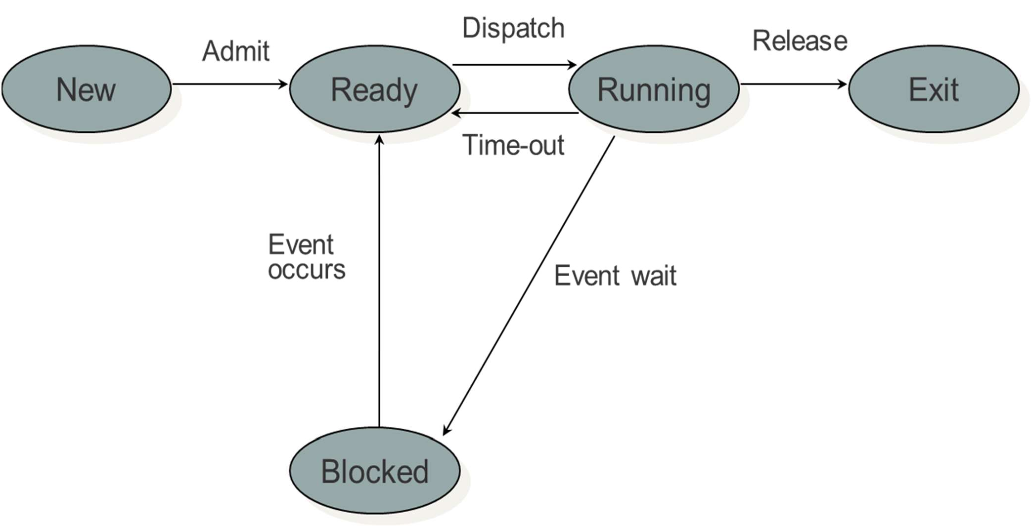
Five-state Process Model

Slide 21
Scheduling Queues
Job queue – set of all processes in the system.
Ready queue – set of all processes residing in main memory, ready and waiting to execute.
Device queues – set of processes waiting for an I/O device.
Process migration between the various queues.

Slide 22
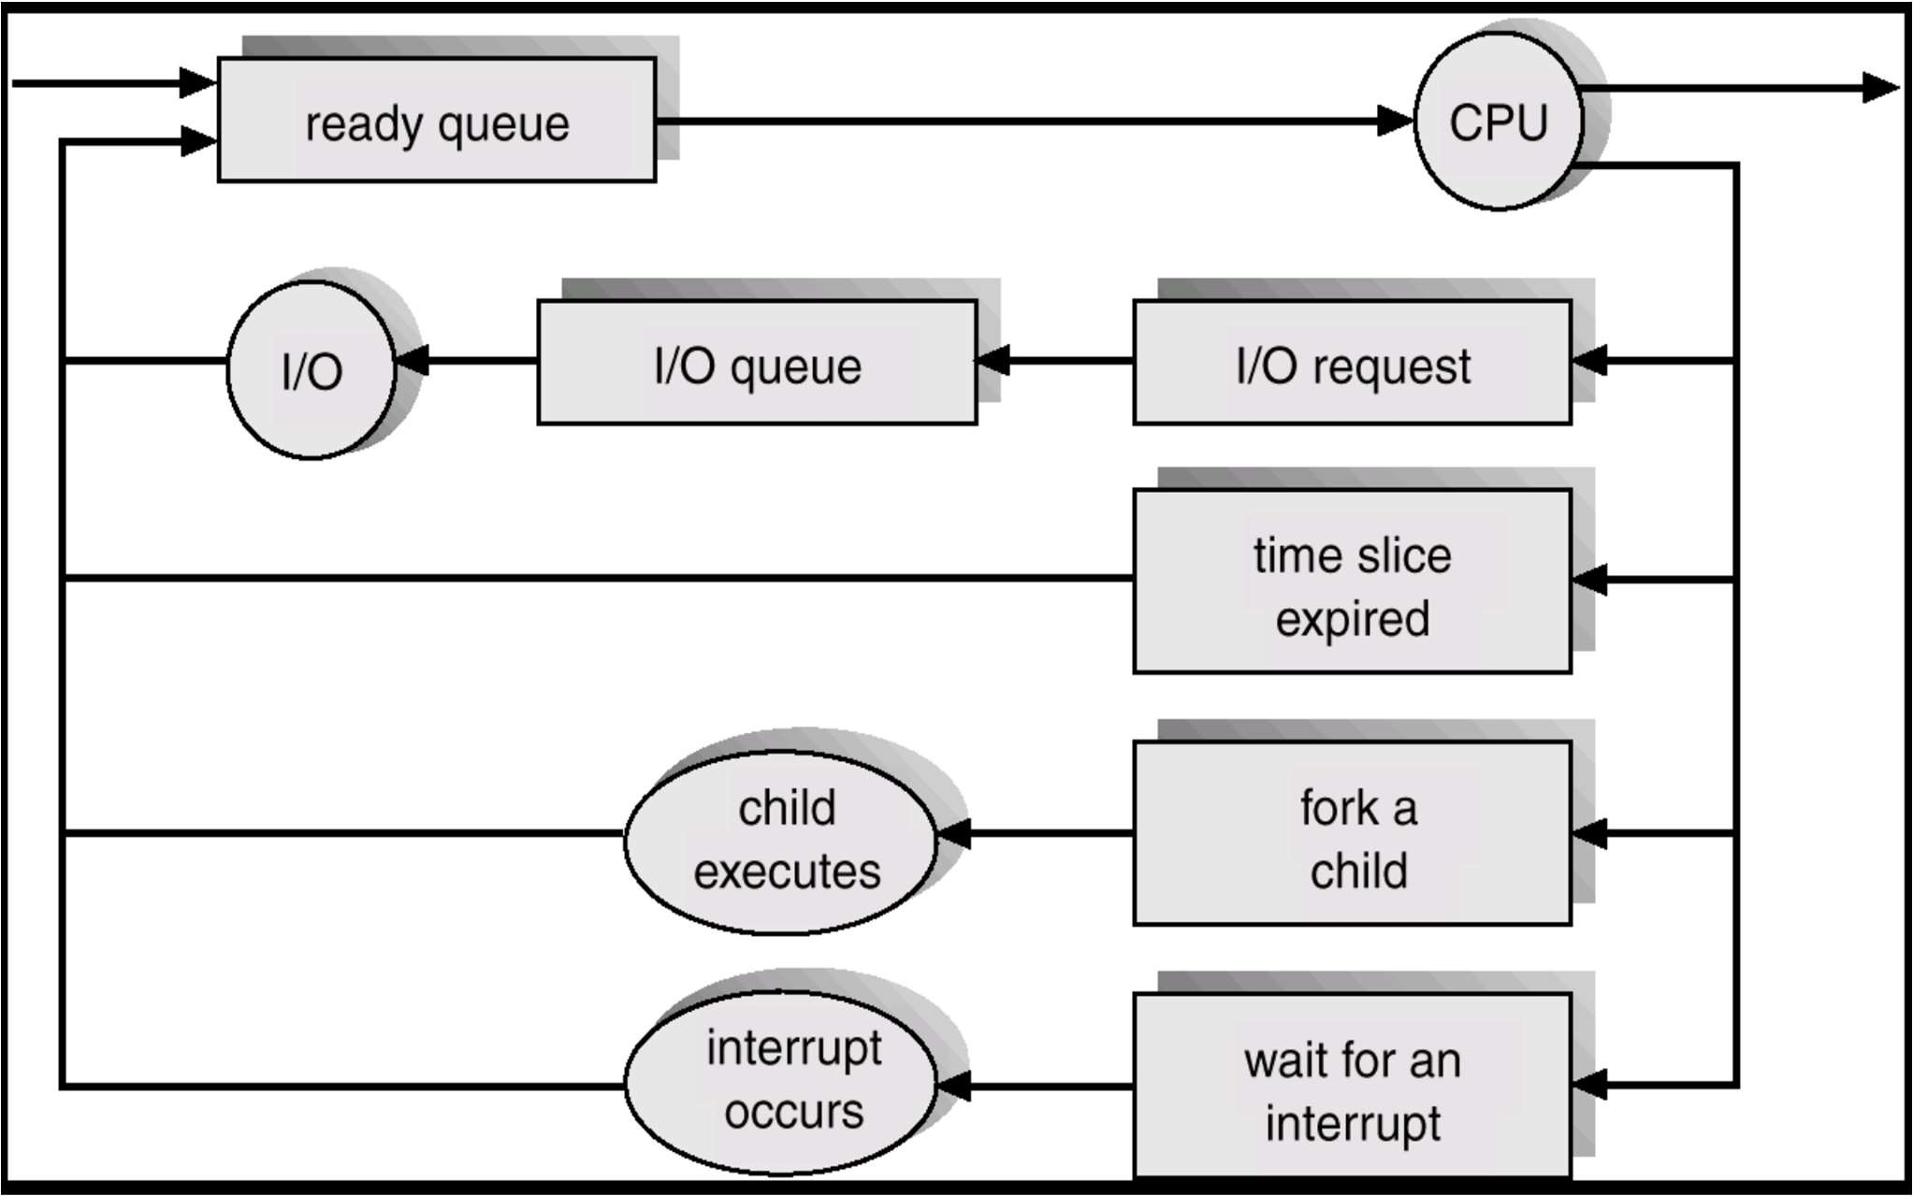
Process Scheduling View

Slide 23
Scheduling Queues
The queues are generally stored as linked lists
A queue header points to the first and the final PCB’s in the list
We extend each PCB to include a pointer field that points to the next PCB in the ready queue

Slide 24
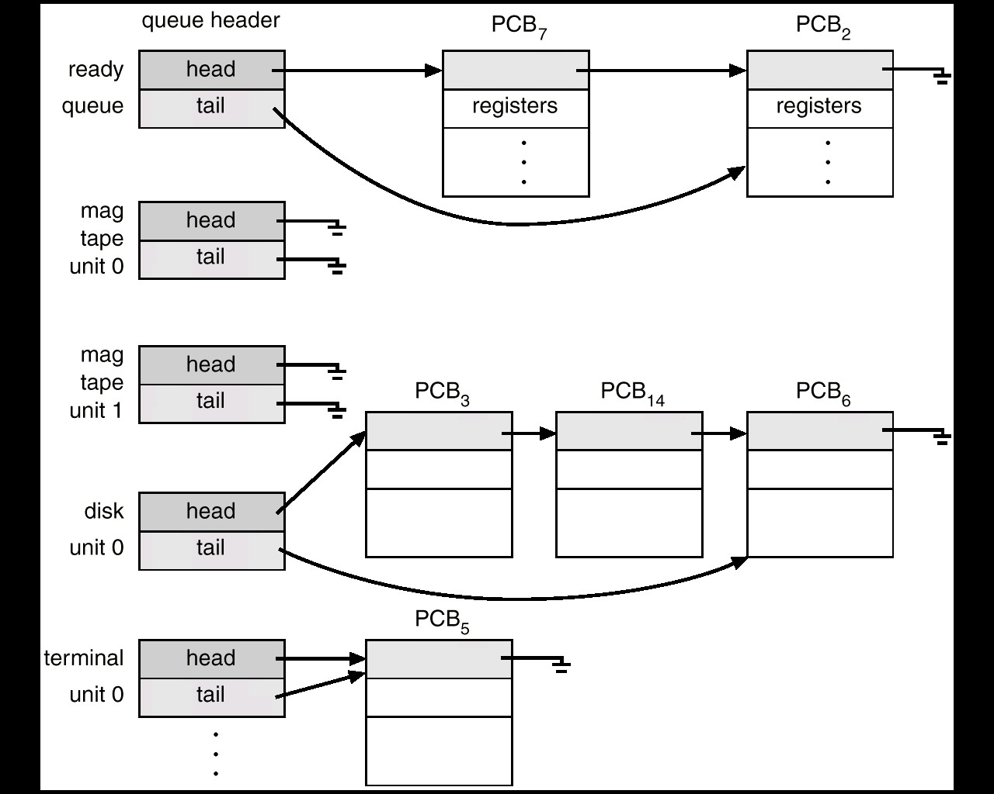
Scheduling Queues

Slide 25
Operations on Processes

Slide 26
Process Creation
Parent process create children processes, which, in turn create other processes, forming a tree of processes
Resource sharing
Parent and children share all resources
Children share subset of parent’s resources
Parent and child share no resources
Execution
Parent and children execute concurrently
Parent waits until children terminate

Slide 27
Process Creation (Cont.)
Address space
Child duplicate of parent
Child has a program loaded into it
UNIX examples
fork system call creates new process
exec system call used after a fork to replace the process memory space with a new program

Slide 28
Process Creation
Includes
Build kernel data structures
Allocate memory
Reasons to create a process
Submit a new batch job/Start program
User logs on to the system
OS creates on behalf of a user (printing)
Spawned by existing process

Slide 29
Unix Process Creation
When the system starts up it is running in kernel mode
There is only one process, the initial process.
At the end of system initialization, the initial process starts up another kernel process.
The init kernel process has a process identifier of 1.

Slide 30
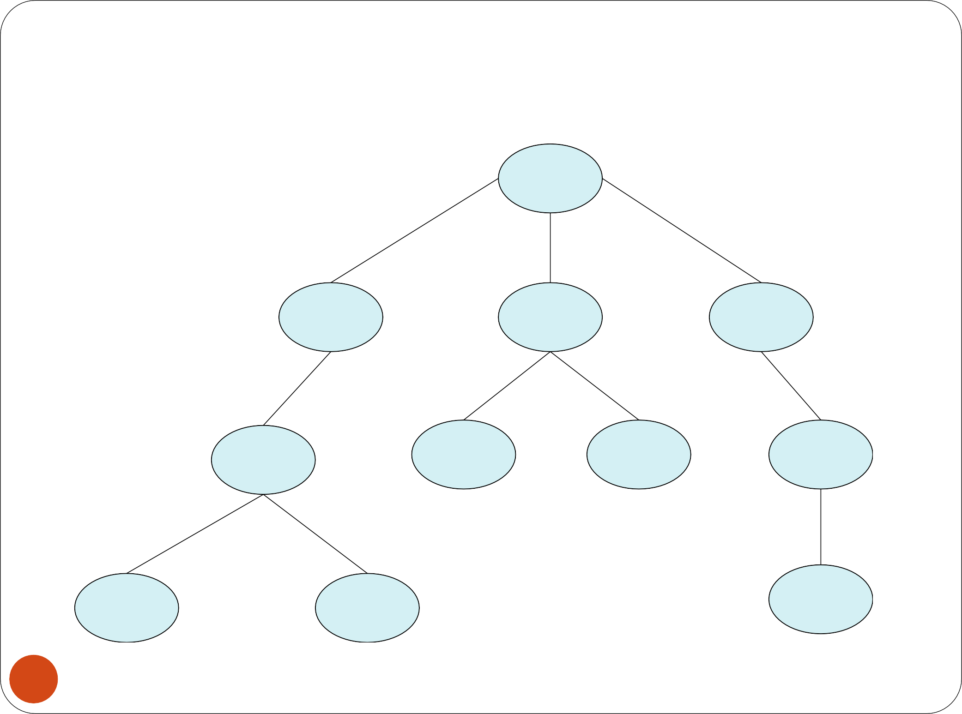
A Tree of Processes in Linux
init pid = 1
login pid = 8415
kthreadd pid = 2
sshd pid = 3028
bash pid = 8416
khelper pid = 6
pdflush pid = 200
sshd pid = 3610
ps pid = 9298
emacs pid = 9204
tcsch pid = 4005

Slide 31
Process Creation
These new processes may themselves go on to create new processes.
All of the processes in the system are descended from the init kernel thread.
You can see the family relationship between the running processes in a Linux system using the pstree command
A new process is created by a fork() system call

Slide 32
The fork() system call
At the end of the system call there is a new process waiting to run once the scheduler chooses it
A new data structure is allocated
The new process is called the child process.
The existing process is called the parent process.
The parent gets the child’s pid returned to it.
The child gets 0 returned to it.
Both parent and child execute at the same point after fork() returns

Slide 33
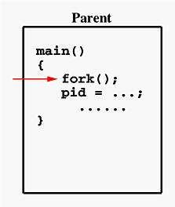
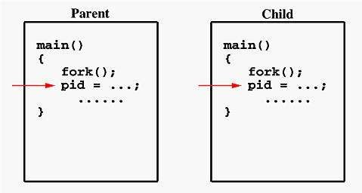
Fork() System call
■ Before calling fork()
■ After calling fork()

Slide 34
Example of fork() system call
#include <stdio.h> #include <sys/types.h> #include <unistd.h>
int main()
{
// make two process which run same
// program running fork() instruction fork();
printf("Hello world!\n"); return 0;
}
Output?
Hello world! Hello world!

Slide 35
Example of fork() system call
#include <stdio.h> #include <sys/types.h> #include <unistd.h>
int main()
{
fork();
fork();
printf("Hello world!\n"); return 0;
}

Slide 36
Exercise – fork()
#include <stdio.h> #include <sys/types.h> int main()
{
fork();
fork();
fork();
printf("hello\n"); return 0;
}
Question: how many times will “hello” be printed?

Slide 37
Unix Process Control
int main()
{
int pid; int x = 0;
Minimal checking for error conditions
Potential for confusion about open files and which program is writing to a file
The new process created by the fork or exec has the three standard files that are automatically opened: stdin, stdout, and stderr.
If the parent has buffered output that should appear before output from the child, the buffers must be flushed before the fork
If the parent and the child processes both read input from a stream, whatever is read by one process will be lost to the other
Once something has been delivered from the input buffer to a process the pointer has moved on
x = x + 1; fork();
x = 3;
printf(“%d”,x)
;
}
48
CS-2006 Operating Systems

Slide 38
But we want the child process to do something else…
The fork syscall returns a zero to the child and the child process ID to the
int pid;
parent
int status = 0;
pid = fork();
Parent uses wait to
p until the
d exits; wait rns child pid status.
^{slee} Fork creates an
^{chil} exact copy of the
if (pid>0) {
/* parent */
……
pid = wait(&status);
} else {
/* child */
…… exit(status);
^{retu} parent process
and
Wait variants allow wait on a
specific child, or
Child process
notification of stops and other signals
passes status back to parent on exit,
}
to report
success/failure
49
CS-2006 Operating Systems

Slide 39
Output with fork() system call
void forkexample()
{
int x = 1;
if (fork() == 0)
printf("Child has x = %d\n", ++x);
else
printf("Parent has x = %d\n", --x);
}
int main()
{
forkexample();
return 0;
}
void forkexample()
{
if (fork() == 0)
printf("Hello from Child!\n");
else
printf("Hello from Parent!\n");
}
int main()
{
forkexample();
return 0;
}
Output
Parent has x = 0
Child has x = 2
Output
Hello from Child!
Hello from Parent!
OR
Child has x = 2
Parent has x = 0
OR
Hello from Parent!
Hello from Chil!

Slide 40
Problems based on C fork()
for (int i = 1; i <= 2; i++)
{
fork();
printf("%d, fork \n",i);
}
HOW many outputs will be there? Also when i<=3?
The total number of child processes created is?

Slide 41
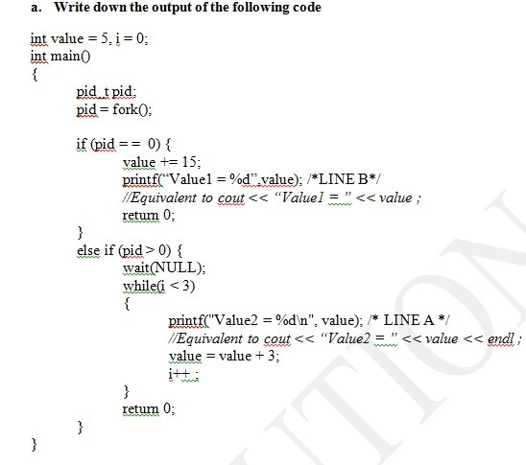
50
CS-2006 Operating Systems

Slide 42
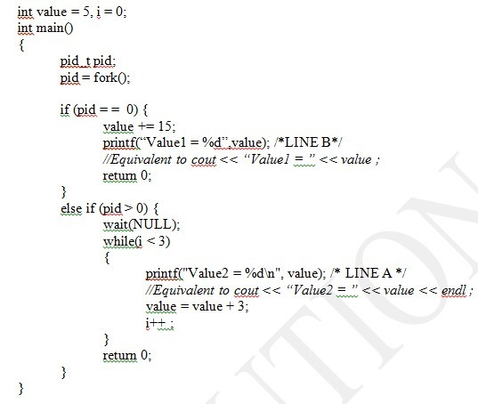
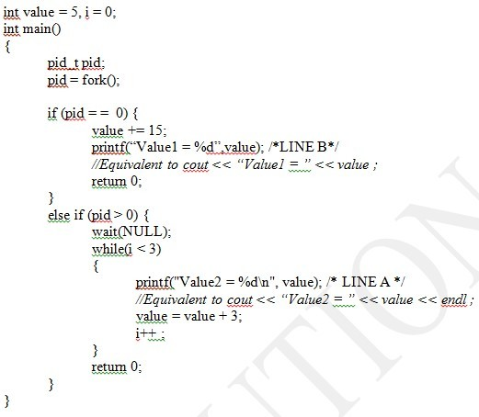
Parent
Child
₅₁ CS-2006 Operating Systems

Slide 43
Child Process Inherits
Stack
Memory
Environment
Open file descriptors
Current working directory
Resource limits
Root directory

Slide 44
Child process DOES NOT Inherit
Process ID
Different parent process ID
Process times
Own copy of files
Resource utilization (initialized to zero)

Slide 45
The wait() System Call
The parent process will often want to wait until all child processes have been completed. This can be implemented with the wait() function call.
wait(): Blocks calling process until the child process terminates. If child process has already teminated, the wait() call returns immediately.
waitpid(): Options available to block calling process for a particular child process not the first one.

Slide 46
The wait() System Call
A child program returns a value to the parent, so the parent must arrange to receive that value
The wait() system call serves this purpose
pid_t wait(int *status)
it puts the parent to sleep waiting for a child’s result
when a child calls exit(), the OS unblocks the parent and returns the value passed by exit() as a result of the wait call (along with the pid of the child)
if there are no children alive, wait() returns immediately
also, if there are zombies, wait() returns one of the values immediately (and deallocates the zombie)

Slide 47
Demonstrate all possible outputs.
// C program to demonstrate working of wait() #include<stdio.h>
#include<sys/wait.h> #include<unistd.h>
int main()
{
if (fork()== 0)
printf("HC: hello from child\n");
else
{
printf("HP: hello from parent\n"); wait(NULL);
printf("CT: child has terminated\n");
}
printf("Bye\n"); return 0;
}

Slide 48
What is a zombie?
When a process ends, all of the memory and resources associated with it are deallocated so they can be used by other processes. However, the process's entry in the process table remains. The parent can read the child's exit status by executing the wait system call, at which stage the zombie is removed. The wait call may be executed in sequential code, but it is commonly executed in a handler for the SIGCHLD signal, which the parent receives whenever a child has died.

Slide 49
What is a zombie?
 After the zombie is removed, its process ID and entry in the process table can then be reused. However, if a parent fails to call wait, the zombie will be left in the process table. In some situations this may be desirable, for example if the parent creates another child process it ensures that it will not be allocated the same process ID. On modern UNIX-like systems (that comply with Single Unix Specification v3 in this respect), the following special case applies: if the parent explicitly ignores SIGCHLD by setting its handler to SIG_IGN (rather than simply ignoring the signal by default) or has the SA_NOCLDWAIT flag set, all child exit status information will be discarded and no zombie processes will be left.

Slide 50
What is a zombie?
Since there is no memory allocated to zombie processes except for the process table entry itself, the primary concern with many zombies is not running out of memory, but rather running out of process ID numbers.
To remove zombies from a system, the SIGCHLD signal can be sent to the parent manually, using the kill command. If the parent process still refuses to reap the zombie, the next step would be to remove the parent process. When a process loses its parent, init becomes its new parent. Init periodically executes the wait system call to reap any zombies with init as parent.

Slide 51
What is a zombie?
In the interval between the child terminating and the parent calling wait(), the child is said to be a ‘zombie’.
Even though its not running its taking up an entry in the process table.
The process table has a limited number of entries.

Slide 52
What is a zombie?
If the parent terminates without calling wait(), the child is adopted by init.
The solution is:
Ensure that your parent process calls wait() or waitpid or etc, for every child process that terminates.

Slide 53
Zombie vs. Orphan Process
A zombie process is not the same as an orphan process. An orphan process is a process that is still executing, but whose parent has died. They do not become zombie processes; instead, they are adopted by init (process ID 1), which waits on its children.
On Unix and Unix-like computer operating systems, a zombie process or defunct process is a process that has completed execution but still has an entry in the process table. This entry is
still needed to allow the process that started the (now zombie) process to read its exit status. The term zombie process derives
from the common definition of zombie—an undead person. In the term's colorful metaphor, the child process has died but has not yet been reaped. Also, unlike normal processes, the kill command has no effect on a zombie process.

Slide 54
Process Termination
Batch job issues Halt instruction
User logs off
Process executes a service request to terminate
Parent terminates so child processes terminate
Operating system intervention
such as when deadlock occurs
Error and fault conditions
E.g. memory unavailable, protection error, arithmetic error, I/O failure, invalid instruction

Slide 55
Process Termination
Process executes last statement and asks the operating system to delete it (exit).
Output data from child to parent (via wait).
Process resources are deallocated by operating system.
Parent may terminate execution of children processes (abort).
Child has exceeded allocated resources.
Task assigned to child is no longer required.
Parent is exiting.
Operating system does not allow child to continue if its parent terminates
Cascading termination

Slide 56
exit()
void exit(int status);
After the program finishes execution, it calls exit()
This system call:
takes the “result” of the program as an argument
closes all open files, connections, etc.
deallocates memory
deallocates most of the OS structures supporting the process
checks if parent is alive:
If so, it holds the result value until parent requests it, process does not really die, but it enters the zombie/defunct state
If not, it deallocates all data structures, the process is dead

Slide 57
exec()
exec is the name of a family of functions that includes execl, execv, execle, execve, execlp, and execvp. They all have the function of transforming the calling process into a new process. The reason for the variety is to provide different ways of pulling together and presenting the arguments of the function.
There shall be no return from a successfulexec, because the calling process image is overlaid by the new process image.
A call to any exec function from a process with more than one thread shall result in all threads being terminated and the new executable image being loaded and executed. No destructor functions or cleanup handlers shall be called.

Slide 58
exec()
If one of the exec functions returns to the calling process image, an error has occurred; the return value shall be -1, and errno shall be set to indicate the error.
The new process shall inherit at least the following attributes from the calling process image:
Process ID
Parent process ID
Process group ID
Session membership
Real user ID
Real group ID
Supplementary group IDs
Time left until an alarm clock signal (see alarm())
Current working directory
Root directory

Slide 59
exec()
We usually want the child process to run some other executable file
For Example,l s list directory contents
Overlays, performed by the family of exec system calls, can change the executing program, but can not create new processes.

Slide 60
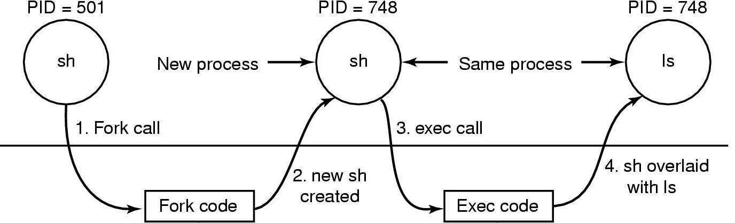
The lsCommand
Steps in executing the command ls type to the shell

Slide 61
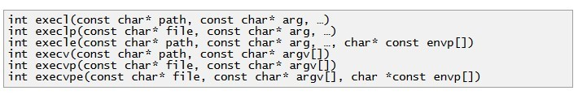
exec()- Variations
e: It is an array of pointers that points to environment variables and is passed explicitly to the newly loaded process.
l: l is for the command line arguments passed a list to the function
p: p is the path environment variable which helps to find the file passed as an argument to be loaded into process.
v: v is for the command line arguments.These are passed as an array of pointers to the function.

Slide 62
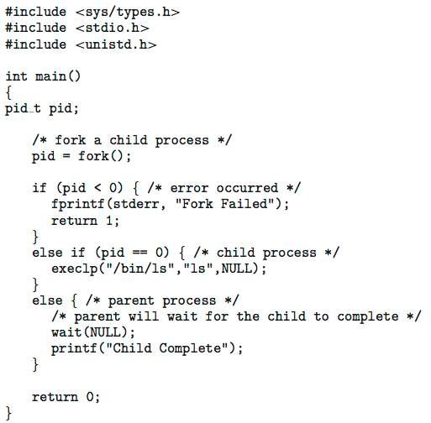
C Program Forking Separate Process

Slide 63
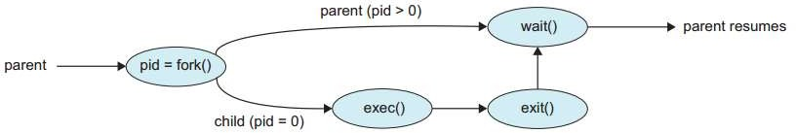
Process Creation

Slide 64
Example-- Fork()
#include <stdio.h> #include <stdlib.h> #include <sys/types.h> #include <unistd.h>
int main(int argc, char *argv[])
{
pid_t new_pid; new_pid = fork(); switch(new_pid)
{
case -1 : /* Error */ printf("Error"); break;
case 0 : /* I am child */ printf("Child");
break;
default : /* I am parent */ printf("Parent");
break;
}
}

Slide 65
Example-- Fork()
#include <stdio.h> #include <unistd.h> #include <iostream> using namespace std; int main()
{
cout<<"A\n"; pid_t p1 = fork(); if( p1 == 0 )
{
cout<<"B\n"; fork();
}
else
{
cout<<"C\n";
}
cout<<"D\n"; return 0;
}

Slide 66
Example-- exec
#include <stdio.h> #include <unistd.h> #include<iostream> using namespace std;
int main(int argc, char *argv[])
{
for(int i=1; i < argc; i++)
{
if(fork()==0)
{
execlp(argv[i],argv[i],NULL); cout<<"exec complete<<endl";
}
}
return 0;
}CS-2006 Operating Systems
75

Slide 67
Example-- fork, exec, wait
using namespace std; int main()
{
char *argv[10]; cout<<"Enter filename: "; argv[0]="gedit"; cin>>argv[1]; argv[2]=NULL;
pid_t = pid; int status;
if((pid = fork()<0)// forking child process
{
printf(""forking child process failed\n"); exit(1);
}
else if(pid == 0)
{
execvp(*argv,argv);
}
else
{
while(wait(&status)!=pid);// parent process wait for completion of child process completion
C} S-2006 Operating Systems
}
76

Slide 68
Example-- fork, exec, wait
#include <stdio.h>
#include <stdlib.h> #include <sys/types.h>
int main ()
{
#include <unistd.h> /* The argument list to pass to the "ls"
int spawn (char* program, char** arg_list) ^{command.}
*/
{
pid_t child_pid;
char* arg_list[] = {
"ls", /* argv[0], the name of the program. */
"-l",
"/",
/* Duplicate this process. */ child_pid = fork ();
if (child_pid != 0)
NULL /* The argument list must end with a NULL. */
};
/* This is the parent process. */ return child_pid;
else { /* Spawn a child process running the "ls"
/* Now execute PROGRAM, searching for ^{command.}
Ignore the
it in the path. */ returned child process id. */
execvp (program, arg_list);
/* The execvp function returns only if an error occurs. */
fprintf (stderr, "an error occurred in execvp\n");
abort ();
}
}
spawn ("ls", arg_list);
printf ("done with main program\n");
return 0;
}
77
CS-2006 Operating Systems

Slide 69
Example-- fork, exec, wait, Exit
#include <stdio.h> #include <stdlib.h> #include <sys/types.h> #include <unistd.h> #include <sys/wait.h>
printf("Child: my parent's pid is: %d\n\n", parent_pid);
printf("Child: I will sleep 3 seconds and then execute - date - command \n\n");
sleep(3);
printf("Child: Now, I woke up and am executing date command \n\n"); execl("/bin/date", "date", 0, 0);
perror("execl() failure!\n\n");
int main( int argc, char *argv[], char *env[] )
{
pid_t my_pid, parent_pid, child_pid; int status;
printf("This print is after execl() and should not have been executed if execl were successful! \n\n");
/* get and print my pid and my parent's pid. */
_exit(1);
}
/*
* parent process
*/
else
{
printf("\nParent: I created a child process.\n\n"); printf("Parent: my child's pid is: %d\n\n", child_pid); system("ps -acefl | grep ercal"); printf("\n \n"); wait(&status); /* can use wait(NULL) since exit status
from child is not used. */
printf("\n Parent: my child is dead. I am going to leave.\n \n ");
}
my_pid = getpid(); parent_pid = getppid(); printf("\n Parent: my pid is %d\n\n", my_pid);
printf("Parent: my parent's pid is %d\n\n", parent_pid);
/* print error message if fork() fails */ if((child_pid = fork()) < 0 )
{
perror("fork failure"); exit(1);
}
/* fork() == 0 for child process */
if(child_pid == 0)
{ printf("\nChild: I am a new-born process!\n\n"); my_pid = getpid(); parent_pid = getppid();
return 0;
}

Slide 70
Example of fork( )
int main(int argc, char **argv)
{
char *name = argv[0]; int child_pid = fork(); if (child_pid == 0) {
printf(“Child of %s sees PID of %d\n”,
name, child_pid);
return 0;
} else {
printf(“I am the parent %s. My child is %d\n”, name, child_pid);
return 0;
}
}
% ./forktest
Child of forktest sees PID of 0
I am the parent forktest. My child is 486

Slide 71
Fork + Exec – shell-like
int main(int argc, char **argv)
{ char *argvNew[5];
int pid;
if ((pid = fork()) < 0)
{
printf( "Fork error\n“);
exit(1);
} else if (pid == 0)
{ /* child process */
argvNew[0] = "/bin/ls"; argvNew[1] = "-l";
argvNew[2] = NULL;
if (execve(argvNew[0], argvNew, environ) < 0)
{ printf( "Execve error\n“);
exit(1);
}
} else
{ /* parent */
wait(pid); /* wait for the child to finish */
}
}

Slide 72
References
Operating System Concepts (Silberschatz, 8th edition) Chapter 3
http://siber.cankaya.edu.tr/OperatingSystems/ceng328/node87
.html
http://www.personal.kent.edu/~rmuhamma/OpSystems/Myos
/processControl.htm
http://www.tutorialspoint.com/operating_system/os_processes
.htm
http://wiki.answers.com/Q/Explain_process_control_block
http://www.gitam.edu/eresource/comp/gvr(os)/4.2.htm
http://www.sal.ksu.edu/faculty/tim/ossg/Process/p_create.ht ml

